Slide 1


Notes:
1

Slide 2

Data Analytics Task 1
Welcome, This presentation provides an overview of the project,
tools used, and key findings.
By Ashish khatke
Project Overview
Project Goals
Mentors
Project Duration
Analyze large datasets
Anish Kumar
Assigned: March 3, 2025
Performing EDA
Prem Kumar Yadav
Submission: March 25, 2025
Extracting useful calculation
Notes:
2

Slide 3
Dataset Overview
Coal prices
Crude Oil & Natural Gas Prices
coal RB 4800 FOB London Close USD
Coal RB 5500 FOB London Close USD
Coal RB 5700 FOB London Close USD
Coal RB 6000 FOB London Current week Avg USD
Coal India 5500 CRF FOB Close USD
Price WTI
Price Brent oil
Price Dubai Brent oil
Price Dutch TTF
Price LNG Jap Korea market plants
Price Natural gas
Market Prices
Exchange rates
Price Exxon mobile
Price All share
Price Mining
Price ICE
Price Shenhua
Price ZAR USD
Price Indian energy exchange rate
Notes:
3

Slide 4



Python for Data Preprocessing
Pandas
NumPy
Data manipulation and analysis
Numerical computing
Notes:
4

Slide 5



SQL for Data Querying
2
Data Cleaning
Data Integrity
Data Extraction
1
Database and Table
Statistical Analysis
3
Calculations and trends
Notes:
5

Slide 6
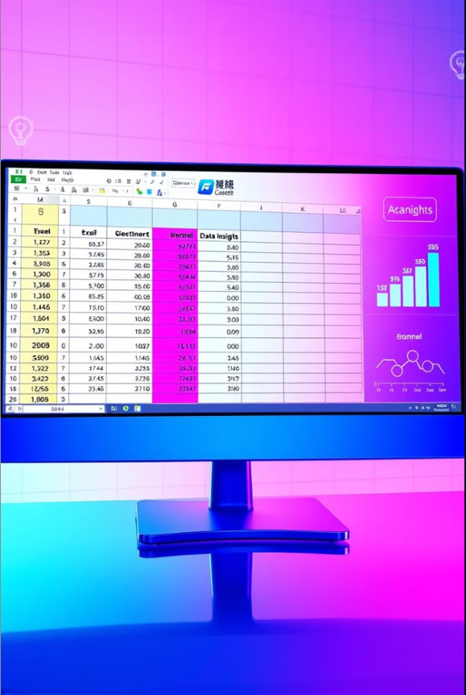



Excel for Data Exploration
Data cleaning
Exploratory
Data Analysis
Excel Formulas & Functions
Notes:
6

Slide 7
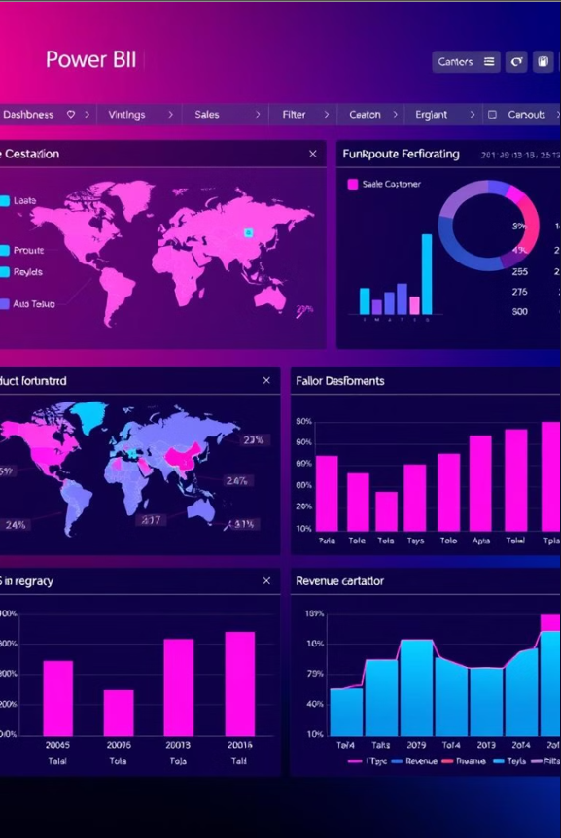



Power BI Interactive Dashboard
Column Selection
Dynamic fields
Data Visualization
Charts and graphs
Statistical Summary
Key metrics
Notes:
7

Slide 8
Thank You
Thank you for this wonderful opportunity!
Notes:
8

